Slide 1


<Name>
<Date>

Slide 2

Outline
Executive Summary
Introduction
Methodology
Results
Conclusion
Appendix

Slide 3
Executive Summary
Summary of methodologies
Collection of SpaceX Data using SpaceX API
Collection of SpaceX Data using Web Scraping
Data Wrangling of SpaceX Data
Exploratory Data Analysis (EDA) of SpaceX Data using SQL
Data Visualization of SpaceX EDA using Python Pandas and Matplotlib
SpaceX Launch Site analysis with Folium Interactive Visual Analytics and Plotly Dashboards.
Machine Learning Predictions of SpaceX Landings
Summary of all results
EDA results
Interactive visual analytics
Predictive analysis via classification

Slide 4
Introduction
Project background and context
SpaceX’s website advertises that their Falcon 9 rocket costs only 62 million USD to launch. This low cost for a rocket launch is achieved by reusing the first stage. If it is possible to predict whether the first stage will land we can cost the launches more accurately. This data could be used by rivals to SpaceX who wish to bid for rocket launch contracts.
Problems you want to find answers
In this project, we predict if the Falcon 9 first stage boosters will land. We achieve this by using the Falcon 9 data provided by SpaceX on their website.

Slide 5

Section 1

Slide 6
Methodology
Executive Summary
Data collection methodology:
Describe how data was collected
Perform data wrangling
Describe how data was processed
Perform exploratory data analysis (EDA) using visualization and SQL
Perform interactive visual analytics using Folium and Plotly Dash
Perform predictive analysis using classification models
How to build, tune, evaluate classification models

Slide 7
Data Collection
How the Falcon launch data sets were collected.
The data was collected from the SpaceX website via API by using a get request to the SPACEX API. This was Achieved by defining multiple helper functions that helped in the extraction of the data by attaching identification numbers to the launch data, then using the get request to get the launch data from the SpaceX API url address.
As we received the data in the JSON format, to ensure consistency we parsed and decoded the data received from the get request and converted this into a pandas data frame.
We also used web scraping to gather historical launch data from Wikipedia, this data was stored in HTML format. By using the BeautifulSoup library, we extracted the tables with data from the Wikipedia web page. We then parsed the data and converted it into another pandas data frame.
You need to present your data collection process use key phrases and flowcharts

Slide 8
Data Collection – SpaceX API
SpaceX Data
Data Sources
We use a RESTful API to extract data from the SpaceX API to GET Falcon 9 launch data, this comes in JSON format, which we parse and decode, then covert into a pandas data frame.
Web scraping code:
https://github.com/JTempletoni/IBM-Data-Capstone/blob/main/2.%20jupyter-labs-webscraping.ipynb
API GET request
Parse and Decode Data
Convert into Pandas Data Frame
API GET request code:
https://github.com/JTempletoni/IBM-Data-Capstone/blob/main/1.%20jupyter-labs-spacex-data-collection-api.ipynb

Slide 9
Data Collection - Scraping
From a Wikipedia web page we use Beautiful Soup to request and extract Falcon 9 launch data from a data table, this comes in HTML format, which we parse and decode, then covert into a pandas data frame.
Web scraping code:
https://github.com/JTempletoni/IBM-Data-Capstone/blob/main/2.%20jupyter-labs-webscraping.ipynb
Wikipedia Data
Data Source
Web Scraping
Parse and Decode Data
Convert into Pandas Data Frame

Slide 10
Data Wrangling
After creating the Pandas data frame from our collected data, we filtered it to only contain Falcon 9 launches.
We first dealt with missing data entries in
We conducted exploratory data analysis (EDA) and determined the labels for training.
We calculated the number of launches at each site and the number and type of orbits.
We also created labels for different landing outcomes and exported this to a csv file.
The data wrangling code:
https://github.com/JTempletoni/IBM-Data-Capstone/blob/main/3.%20labs-jupyter-spacex-Data%20wrangling.ipynb

Slide 11
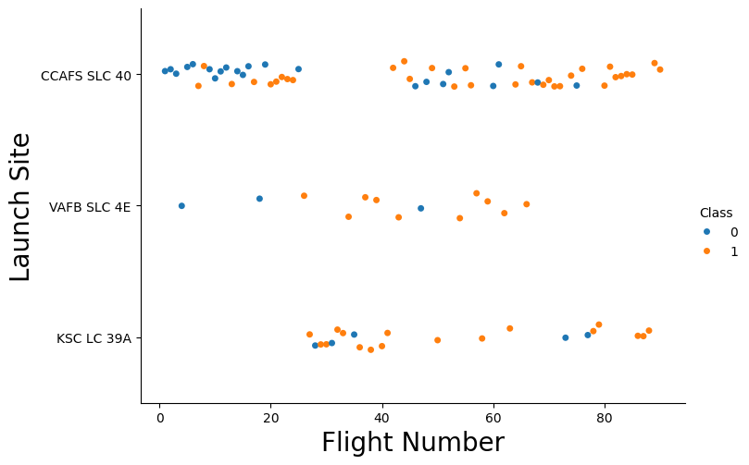
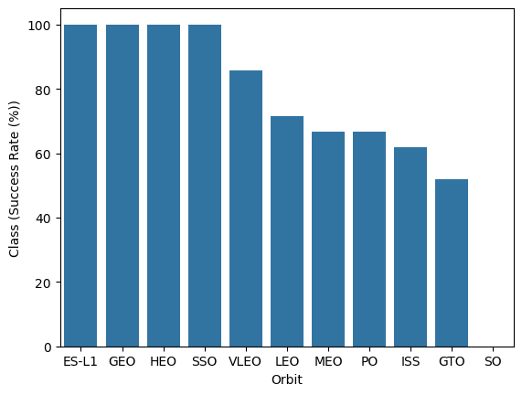
EDA with Data Visualization
We Explored the relationships within the data; e.g. between flight number and launch site, success rates and orbits etc.
GitHub URL:
https://github.com/JTempletoni/IBM-Data-Capstone/blob/main/5.%20edadataviz.ipynb

Slide 12
EDA with SQL
We loaded our SpaceX data into a PostgreSQL database while still in the Jupyter notebook environment.
We conducted EDA on our SQL data base, we used SQL queries to determine:
The unique launch sites
The total mass carried by boosters launched by NASA
The failed landings involving drone ships, including which boosters and launch sites
The total number of successful and failed mission
GitHub URL:
https://github.com/JTempletoni/IBM-Data-Capstone/blob/main/4.%20jupyter-labs-eda-sql-coursera_sqllite.ipynb

Slide 13
Build an Interactive Map with Folium
We built an Folium interactive map of the launch sites by including objects like markers (circles, lines) to mark the success or failures of mission at each launch site.
By using binary classification for success (1) and failure (0), colour coding launch sites based on success rate, we identified which launch sites were most successful.
We added these so that the data could be interpreted interactively and more intuitively, as the EDA shoed that not all launch sites had equal success rate.
GitHub URL:
https://github.com/JTempletoni/IBM-Data-Capstone/blob/main/6.%20lab_jupyter_launch_site_location.ipynb

Slide 14
Build a Dashboard with Plotly Dash
We built an interactive dashboard using Plotly dash
We plotted pie charts showing the total launches by each site
We plotted scatter graphs showing the relationship between outcome and payload mass (kg) for the different booster versions.
GitHub URL:
https://github.com/JTempletoni/IBM-Data-Capstone/blob/main/7.%20spacex-dash-app.py

Slide 15
Predictive Analysis (Classification)
We loaded the data using numpy and pandas then transformed and split the data into subsets for training and testing
We used this to build different machine learning models, we then fine-tuned different sets of hyperparameters by using GridSearchCV to find the optimal hyperparameters for each model. We further improved the models by feature engineering.
We used prediction accuracy as the metric we evaluate our models success on.
The code Github URL: https://github.com/JTempletoni/IBM-Data-Capstone/blob/main/8.%20SpaceX_Machine%20Learning%20Prediction_Part_5.ipynb

Slide 16
Results
Exploratory data analysis results
Interactive analytics demo in screenshots
Predictive analysis results

Slide 17

Section 2

Slide 18
Flight Number vs. Launch Site
A scatter plot of Flight Number vs. Launch Site

Slide 19
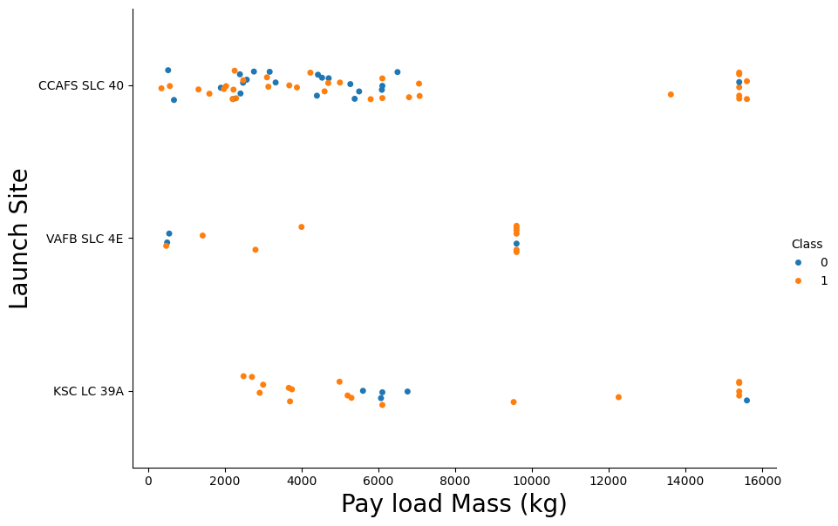
Payload vs. Launch Site
A scatter plot of Payload vs. Launch Site

Slide 20
Success Rate vs. Orbit Type
A bar chart for the success rate of each orbit type

Slide 21
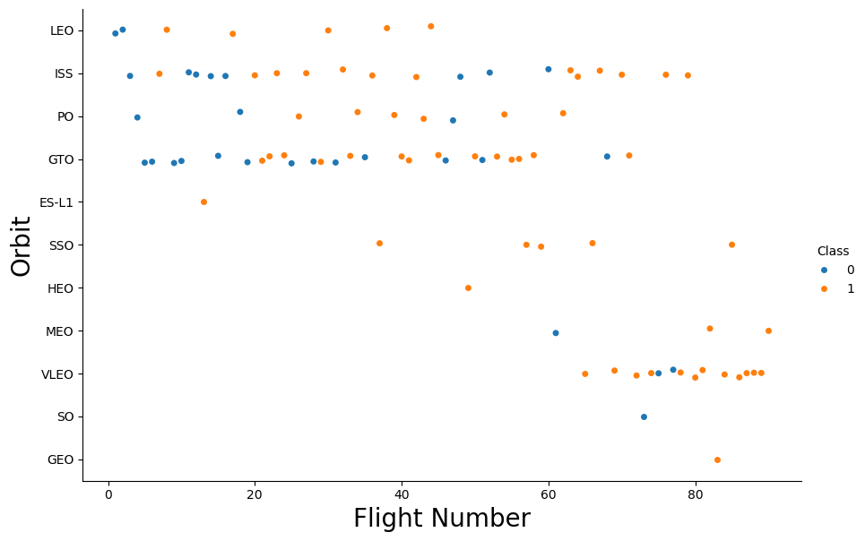
Flight Number vs. Orbit Type
Ascatter point of Flight number vs. Orbit type

Slide 22
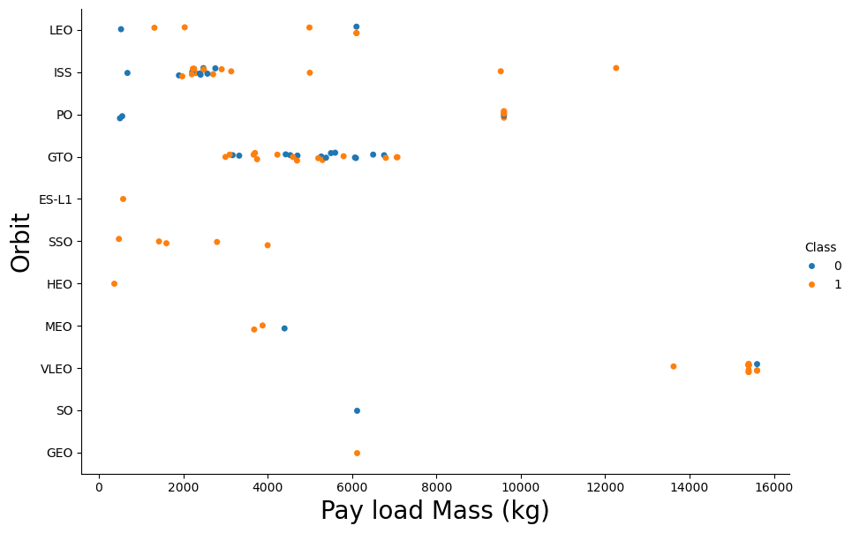
Payload vs. Orbit Type
Ascatter point of payload vs. orbit type

Slide 23
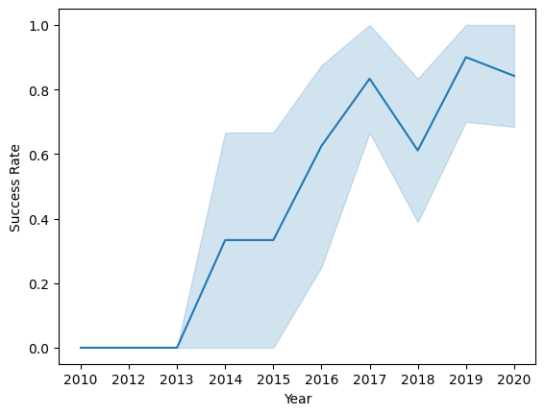
Launch Success Yearly Trend
A line chart of yearly average success rate

Slide 24
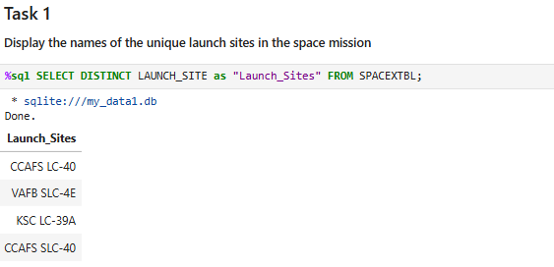
All Launch Site Names
Found the names of the unique launch sites
Used ‘SELECT DISTINCT’ statement to return only the unique launch sites from the ‘LAUNCH_SITE’ column of the SPACEXTBL table.

Slide 25
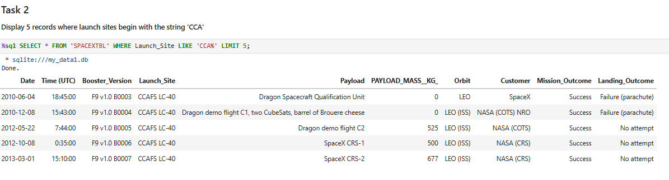
Launch Site Names Begin with 'CCA'
Found 5 records where launch sites begin with `CCA`
Used the ‘LIKE’ command with ‘%’ wildcard in ‘WHERE’ clause to select and display a table of all records where launch sites begin with the string 'CCA’.

Slide 26
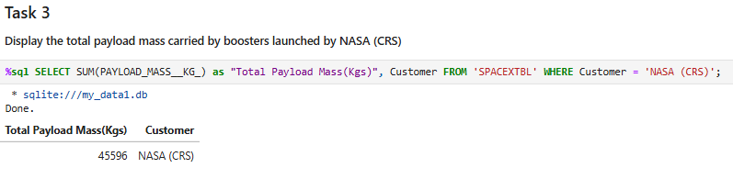
Total Payload Mass
Calculated the total payload carried by boosters from NASA
Used the ‘SUM()’ function to return and display the total sum of the ‘PAYLOAD_MASS_KG’ column for ‘Customer’ ‘NASA(CRS’

Slide 27
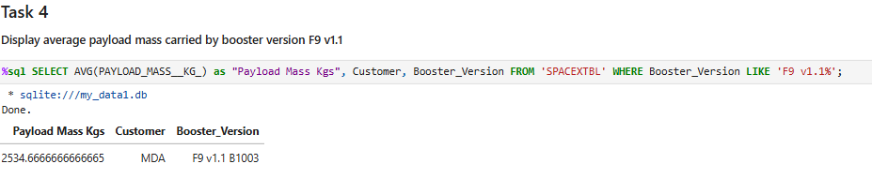
Average Payload Mass by F9 v1.1
Calculated the average payload mass carried by booster version F9 v1.1
• Used the ‘AVG()’ function to return and display the average payload mass carried by booster version F9 v1.1

Slide 28
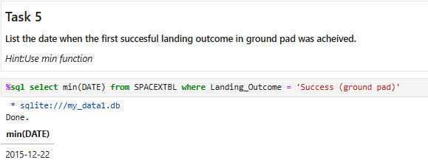
First Successful Ground Landing Date
Find the dates of the first successful landing outcome on ground pad
Used the ‘MIN()’ function to return and display the first date when the first successful landing outcome on ground pad ‘Success (ground pad)’ occured.

Slide 29
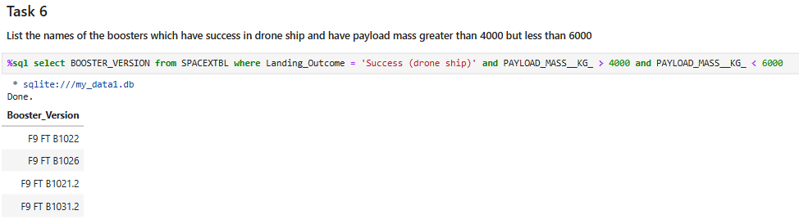
Successful Drone Ship Landing with Payload between 4000 and 6000
List the names of boosters which have successfully landed on drone ship and had payload mass greater than 4000 but less than 6000.
Used ‘Select Distinct’ statement to return and list the ‘unique’ names of boosters with operators >4000 and <6000, thus only listing boosters with payloads between (4000, 6000) with successful landings on drone ships.

Slide 30
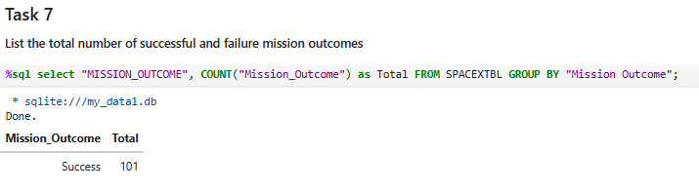
Total Number of Successful and Failure Mission Outcomes
Calculate the total number of successful and failure mission outcomes
Used the ‘COUNT()’ function with the ‘GROUP BY’ statement to return the total number of missions outcomes.

Slide 31
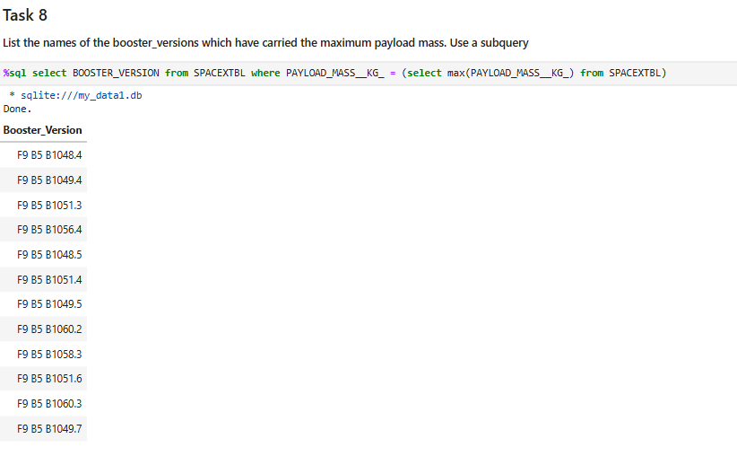
Boosters Carried Maximum Payload
List the names of the booster which have carried the maximum payload mass
• Used a Subquery to return and pass the Max payload and then to list all the boosters that have carried the Max payload of 15600 kg.

Slide 32
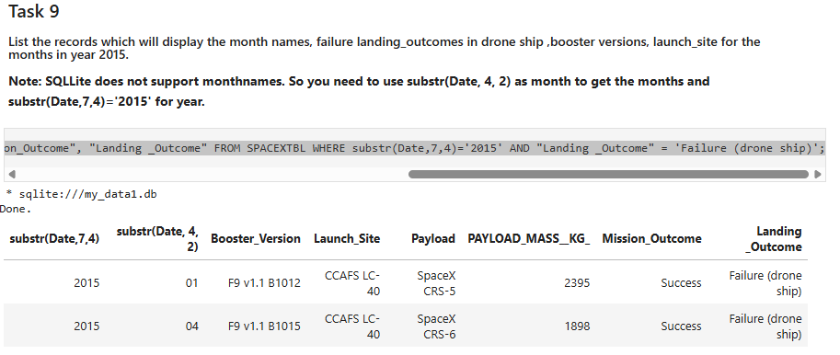
2015 Launch Records
List the failed landing outcomes in drone ship, their booster versions, and launch site names for in year 2015
Used the ‘subsrt()’ in the select statement to get the month and year from the date column where substr(Date,7,4)='2015’. Then for year and ‘Landing_outcome’ was ‘Failure (drone ship)’ to return the records matching the filter.

Slide 33
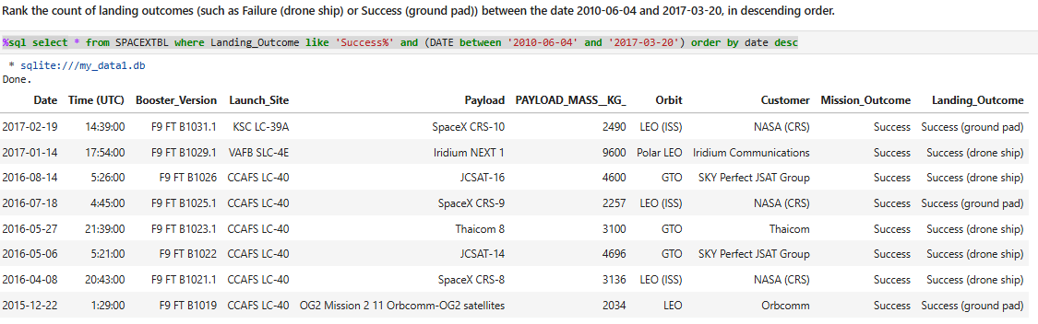
Rank Landing Outcomes Between 2010-06-04 and 2017-03-20
Rank the count of landing outcomes (such as Failure (drone ship) or Success (ground pad)) between the date 2010-06-04 and 2017-03-20, in descending order
Used the SELECT function and filtered by Success and between two dates

Slide 34

Section 3

Slide 35

All launch sites ona global map
All the launch sites are in proximity to the Equator. Also all the launch sites are in very close proximity to the coast.

Slide 36

Launch outcomes for each site on the map
• In Florida launch site KSC LC-39A has a high success rate in comparison to the launch sites CCAFS SLC-40 & CCAFS LC-40.

Slide 37

Distances between a launch site to its proximities (infrastructure)
The launch site is 0.9km from the coastline.

Slide 38

Section 4

Slide 39
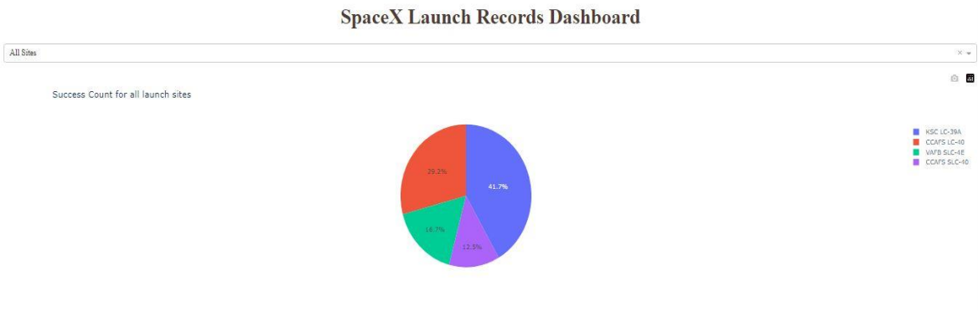
Launch success count for all sites
Launch site KSC LC-39A has the highest launch success rate at 42% followed by CCAFS LC-40 at 29%, VAFB SLC-4E at 17% and lastly launch site CCAFS SLC-40 with a success rate of 13%.

Slide 40
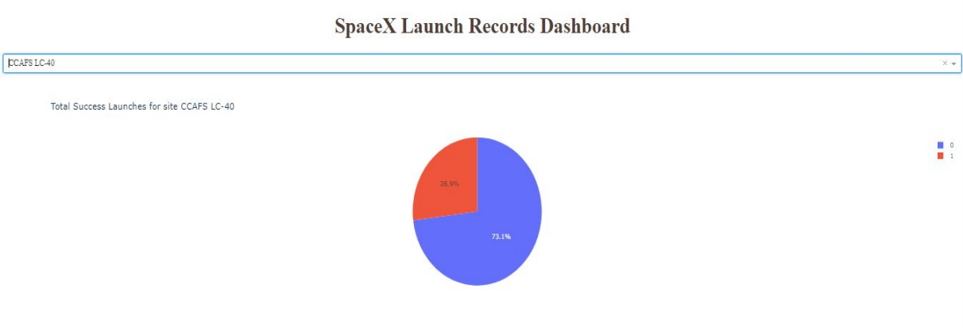
Launch site with highest launch success ratio
Launch site CCAFS LC-40 had the highest success ratio of 73% success against 27% failed launches.

Slide 41
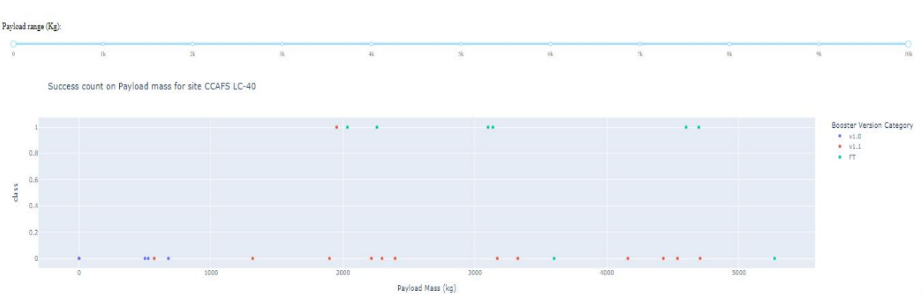
Payload vs. Launch Outcome scatter plot for all sites
For the Launch site CCAFS LC-40 the booster version FT has the largest success rate from a payload mass of >2000kg.

Slide 42

Section 5

Slide 43
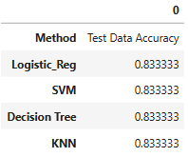
Classification Model Accuracy
All the models performed the same on the test data, achieving the same accuracy of 0.833333.

Slide 44

Confusion Matrix
All the classification models had the same confusion matrices and were able to distinguish between the different classes. All of the models suffered from false positives.

Slide 45
Conclusions
The different launch sites have different success rates. CCAFS LC-40, has a success rate of 60 %, while KSC LC-39A and VAFB SLC 4E has a success rate of 77%.
It can be seen that, as the flight number increases in each of the 3 launch sites, so does the success rate. For instance, the success rate for the VAFB SLC 4E launch site is 100% after the Flight number 50. Both KSC LC 39A and CCAFS SLC 40 have a 100% success rates after their 80th flights.
Orbits ES-L1, GEO, HEO & SSO have the highest success rates at 100%, with SO orbit having the lowest success rate at ~50%.
With heavy payloads the successful landing or positive landing rate are more for Polar, LEO and ISS.
The success rate since 2013 has increased until 2020, showing an improvement in abilities.

Slide 46
Appendix
Include any relevant assets like Python code snippets, SQL queries, charts, Notebook outputs, or data sets that you may have created during this project

Slide 47


